Slide 1
do-while Iteration Statement
ELEC1006: ENGINEERING COMPUTING

Slide 2

Iteration Statement (loops)
Loops are used to repeat a statement a certain number of times when a condition is met.
There are three types of loops:
while loop.
do-while loop. ←
for loop.
PAGE 2

Slide 3
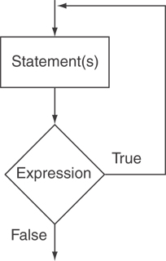
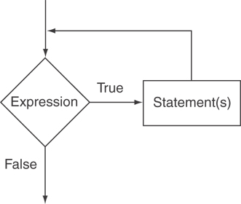
The do-while Loop
The format is:
do { statements } while (expression or condition);
Only difference with the while statement is that do-while evaluates the condition after executing the statements.
do-while Loop Logic
while Loop Logic
PAGE 3

Slide 4
Example
// Number echo
#include <iostream>
using namespace std;
int main ()
{
unsigned long n;
do {
cout << "Enter number (0 to end): ";
cin >> n;
cout << "You entered: " << n << "\n";
} while (n != 0); // Must use ;
return 0;
}
PAGE 4

Slide 5
Notes on do-while
Loop always executes at least once.
Execution continues as long as the expression is true and stops the repetition when the expression becomes false.
Useful in menu-driven programs to bring user back to menu to make another choice.
PAGE 5

Slide 6
Menu –driven Program
#include <iostream>
using namespace std;
int main()
{
int selection; // Selection variable
do {
cout << "Please make a selection: \n"; // List menu
cout << "1) Addition\n";
cout << "2) Subtraction\n";
cout << "3) Multiplication\n";
cout << "4) Division\n";
cin >> selection; // Get user menu selection
} while (selection != 1 && selection != 2 && selection != 3 && selection != 4);
// Do something with the selection here
return 0;
}
PAGE 6

Slide 7
More info
[1] cplusplus.com: Statements and flow control
https://cplusplus.com/doc/tutorial/control/
[2] learncpp.com: 5.6 – Do while statements
https://www.learncpp.com/cpp-tutorial/56-do-while- statements/
PAGE 7

